Slide 1

Capstone Project – 2
Rossmann Sales Prediction
SATYAM JYOTI SANKAR

Slide 2
Content
Defining problem statement
E D A and feature engineering
Feature Selection
Preparing dataset for modeling
Applying Model
Model Validation and Selection
Conclusion

Slide 3
Problem Statement
Rossmann operates over 3000 drug stores in 7 European countries.
Rossmann Managers are tasked with predicting their sales in advance.
The sales are influenced by many parameters and the task is to predict the sales based on the parameters.
In our data set we have sales data for 1,115 Rossmann stores.

Slide 4
Data Summary
The dataset we have 3 yr data - 2013, 2014 and 2015. Below are few important features:
Customer : - The Number of customers on a given day in a store.
State Holiday :- Indicates a state holiday.
Store Type : Differentiate between 4 different store models.
Assortment : Describes an assortment level i.e a : basic, b : extra and c : extended.
Competition Distance : Distance in meters to the nearest competition store.

Slide 5
Data Summary(Contd.)
CompetitionOpenSince[Year/Month] :- Gives the approximate year and month of the time the nearest competitor is opened.
Promo :- Indicates whether a store is running a promo on that day.
Promo2 :- Indicates whether a store is continuing promotion.
Promo2Since[Year/Week] :- Gives the approximate year and calendar week of the time when the store started participating in Promo2.
PromoInterval :- Describes an interval or name of months when the store runs Promo2.

Slide 6
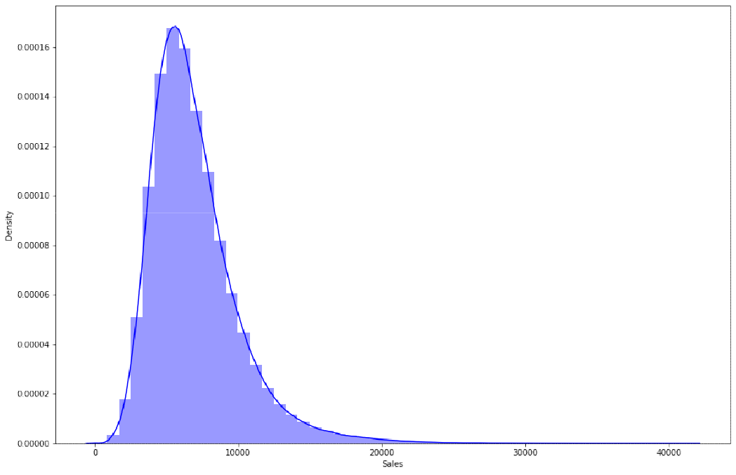
EDA:-Sales - Distribution
The Sales distribution lived up to the expectation with no irregularities.
It seems to be a perfect gaussian distribution with small positive skewness.

Slide 7
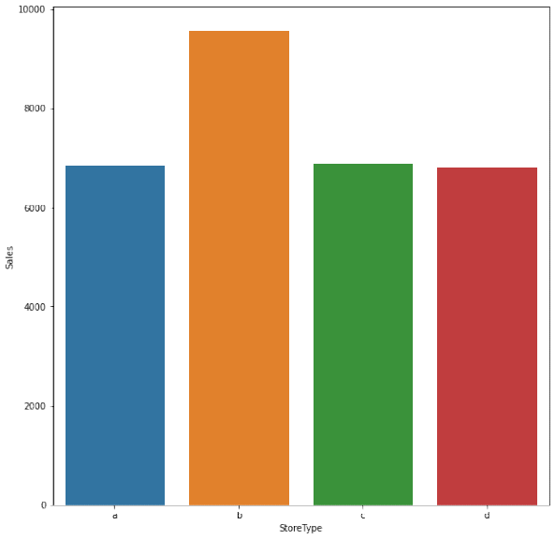
EDA:-Sales VS Store Type

Slide 8
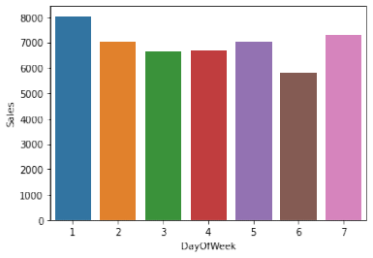
EDA:-Weekly Sales Trend
fd

Slide 9
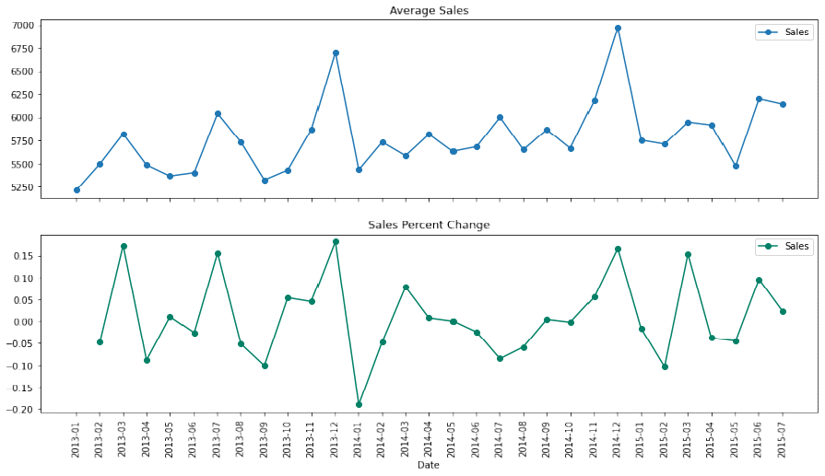
EDA:-Sales month wise in a year

Slide 10
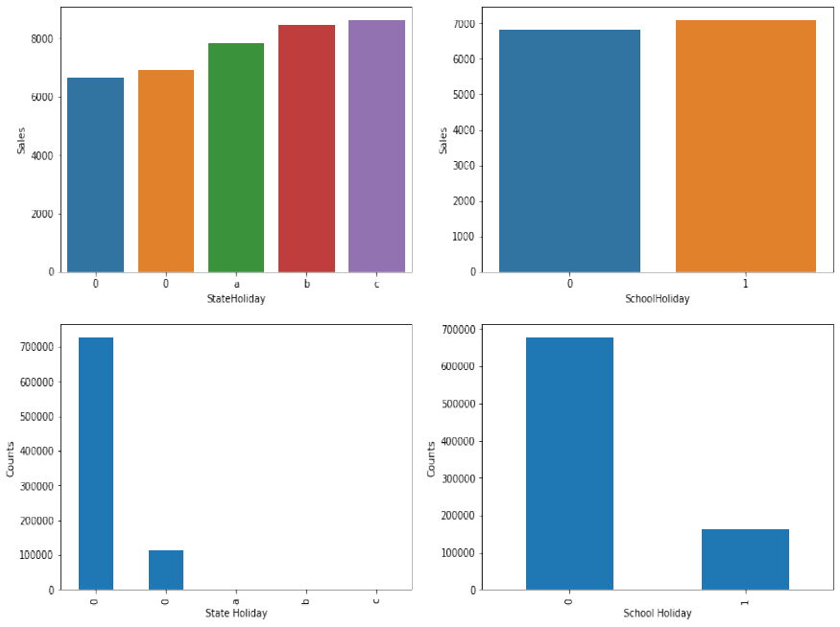
EDA:-Holiday Sales

Slide 11
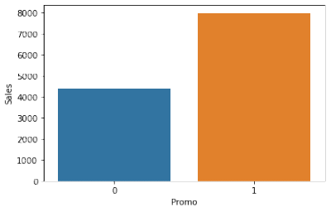
Sales and Promotions
Sales are increasing because of Promotion. Let’s just go ahead with Promotion

Slide 12
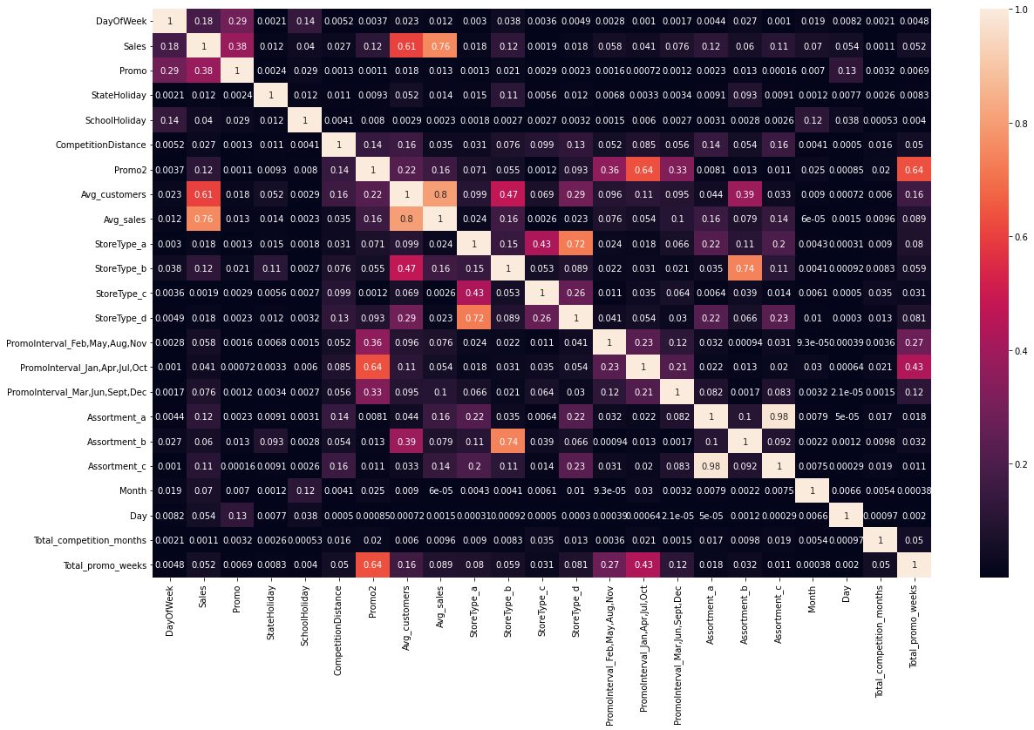
How all other factors affects Sales(heat_map)

Slide 13
EDA Conclusion
There are very few stores open on ‘State Holiday’ and they make a good profit on those days then any average day.
On School Holidays there is no large difference in sale. So promos running on School holidays can be reduced.
Sales for assortment type a and c seems to be less as compared to assortment type b.
At the start of month the sales increases. People might be planning to shop for the entire month in its beginning.
Assortment c and a are highly corelated.

Slide 14
Feature Engineering
Extraction of Year, Month and Date from the Date column.
One hot encoding for Stateholiday, Storetype, Assortment and Promo Interval.
Creating Total Competition month as a new feature by using ‘CompetitionOpenSinceYear’ and ‘CompetitionOpenSinceMonth’.
Creating Total Promotion Year and Total Promotion Week as new features by using ‘Promo2SinceYear’ and ‘Promo2SinceWeek’.
Creating ‘IsPromoMonth’ as a new feature to account for whether a month is promotional or not using ‘PromoInterval’ feature.
Creating ‘Average Sales’ and ‘Average Customers’ columns and dropping the ‘Customers’ column.

Slide 15
Models Used For Prediction
Linear Regression (Baseline Model)
Lasso(Hyperparameter)
Decision tree by using decision tree regressor(Hyperparameter)
Random forest regressor
Gradient Boosting Regression
Xg boost Regressor(Hyperparameter)

Slide 16
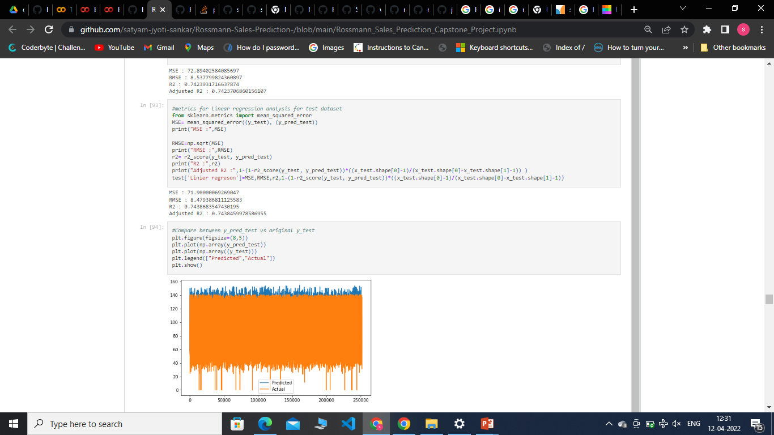
Linear Regression (Baseline Model)
Train_data
Test_data

Slide 17
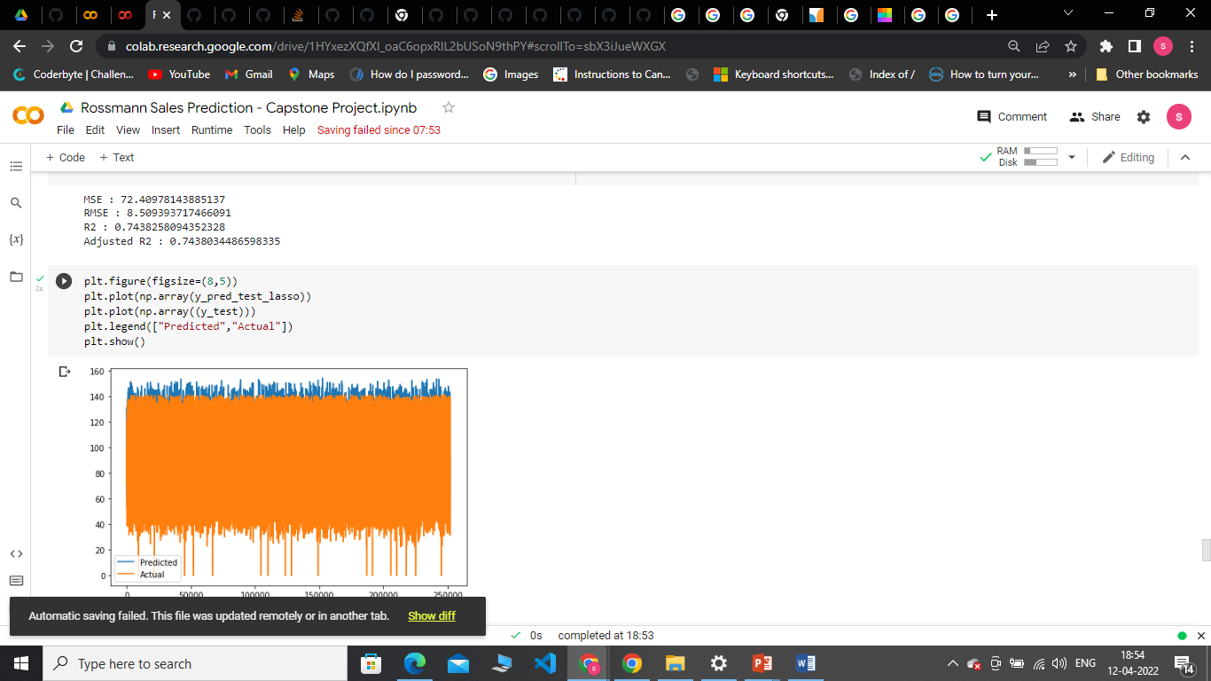
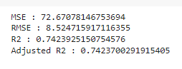
Lasso(Hyperparameter)
Train
Test

Slide 18
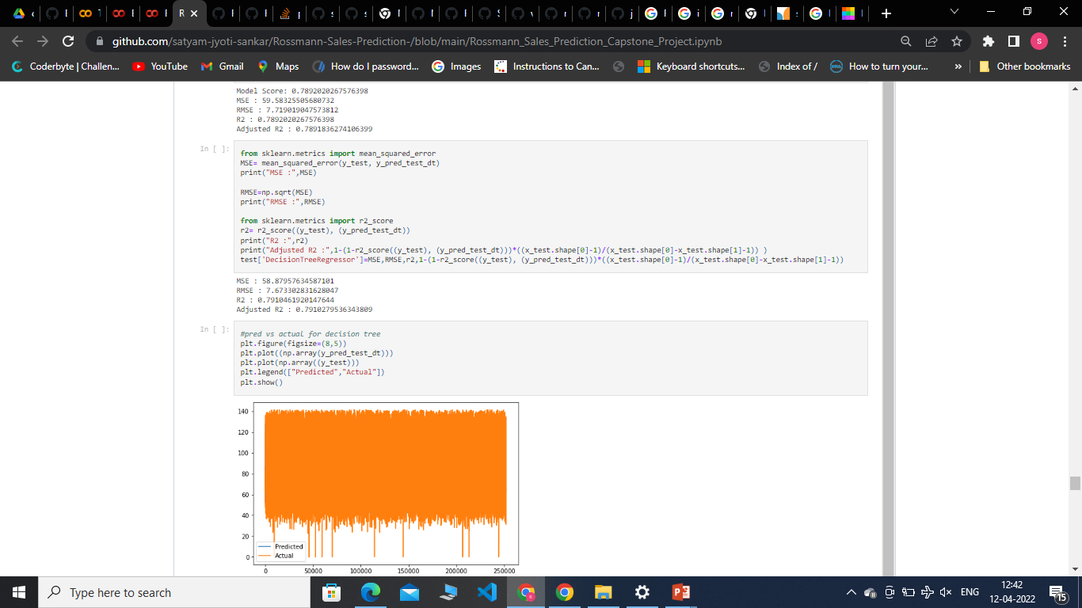
Decision tree by using decision tree regressor(Hyperparameter)
Train_data
Test_data

Slide 19
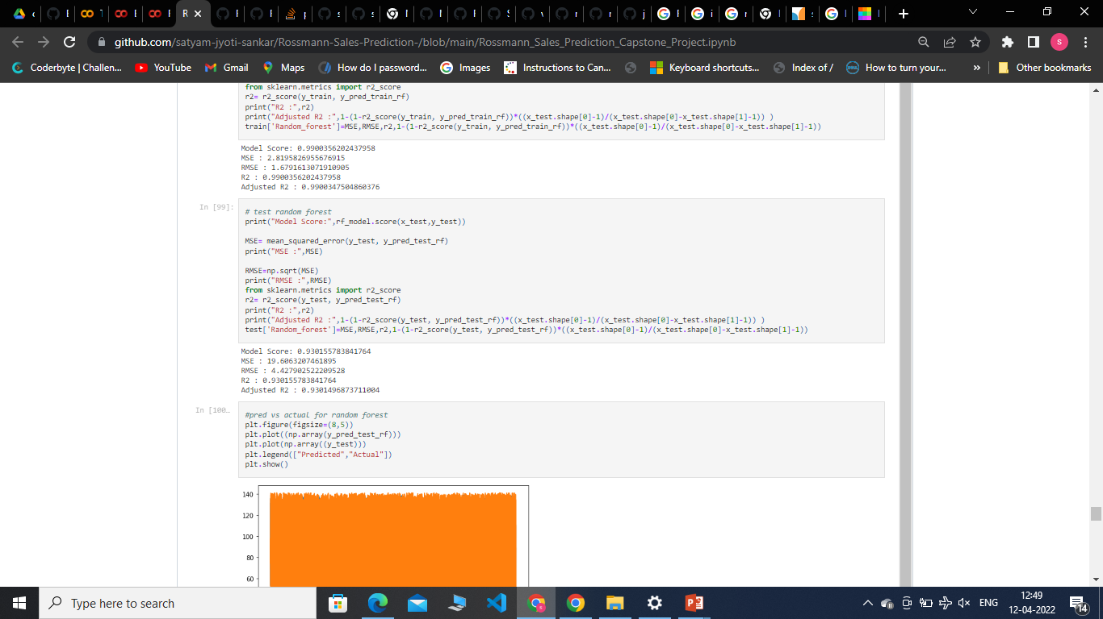
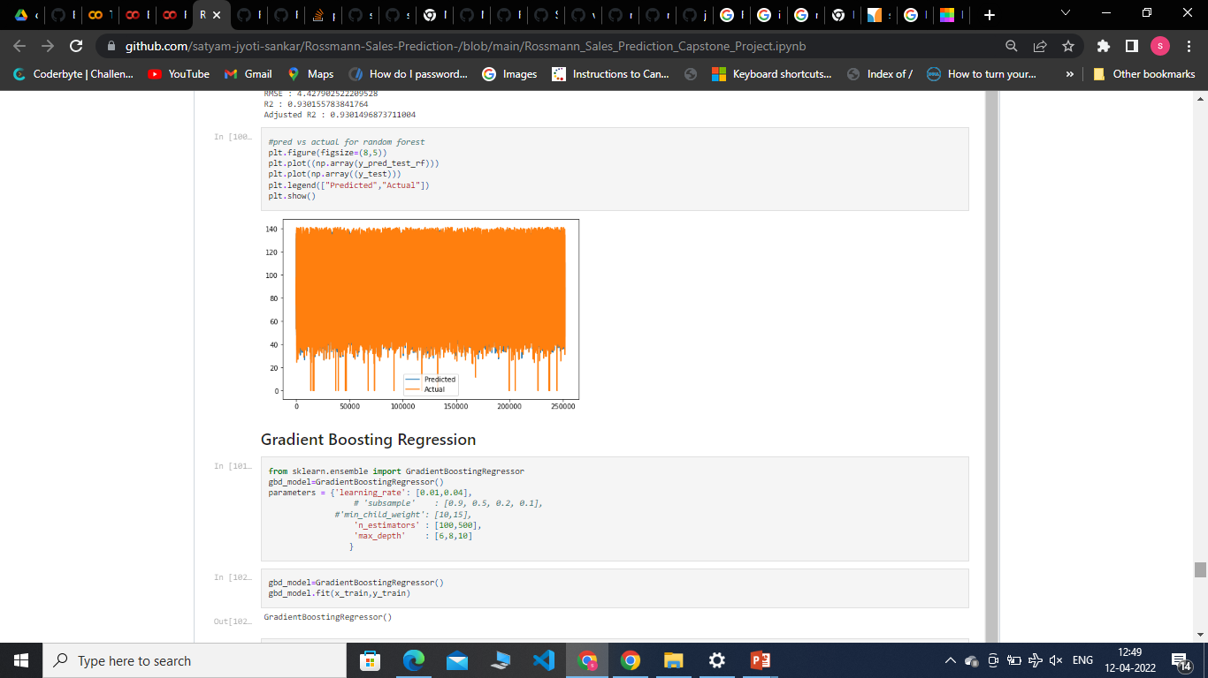
Random forest rergressor
Train
Test

Slide 20
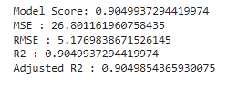
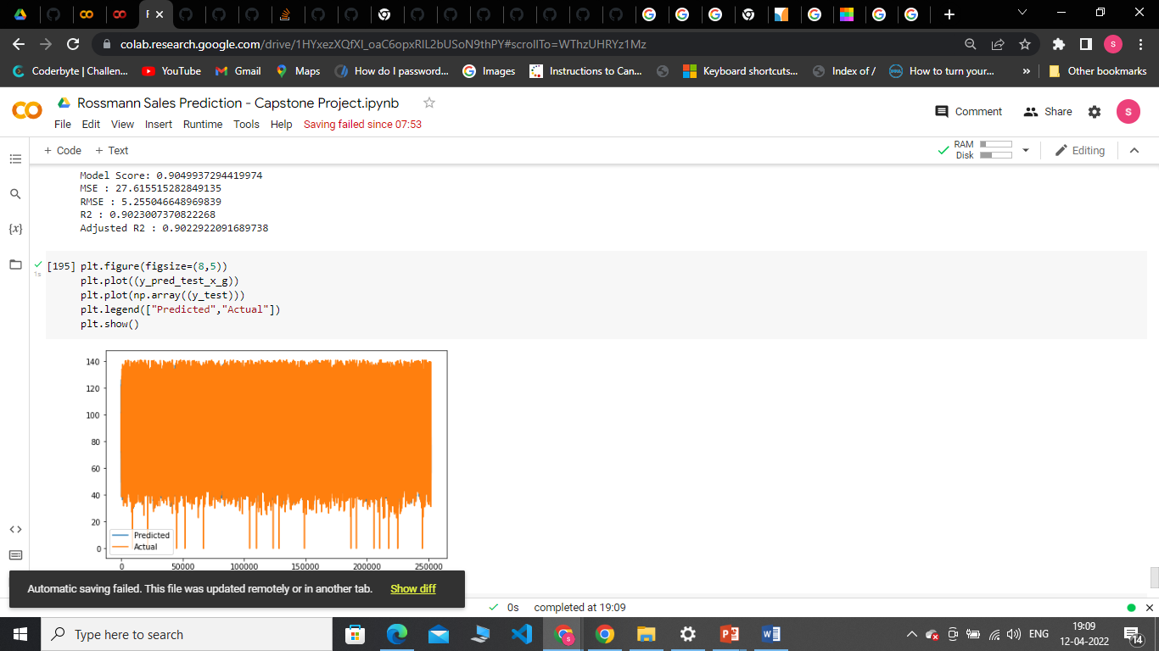
Xgboost Regressor(Hyperparameter)
Train
Test

Slide 21
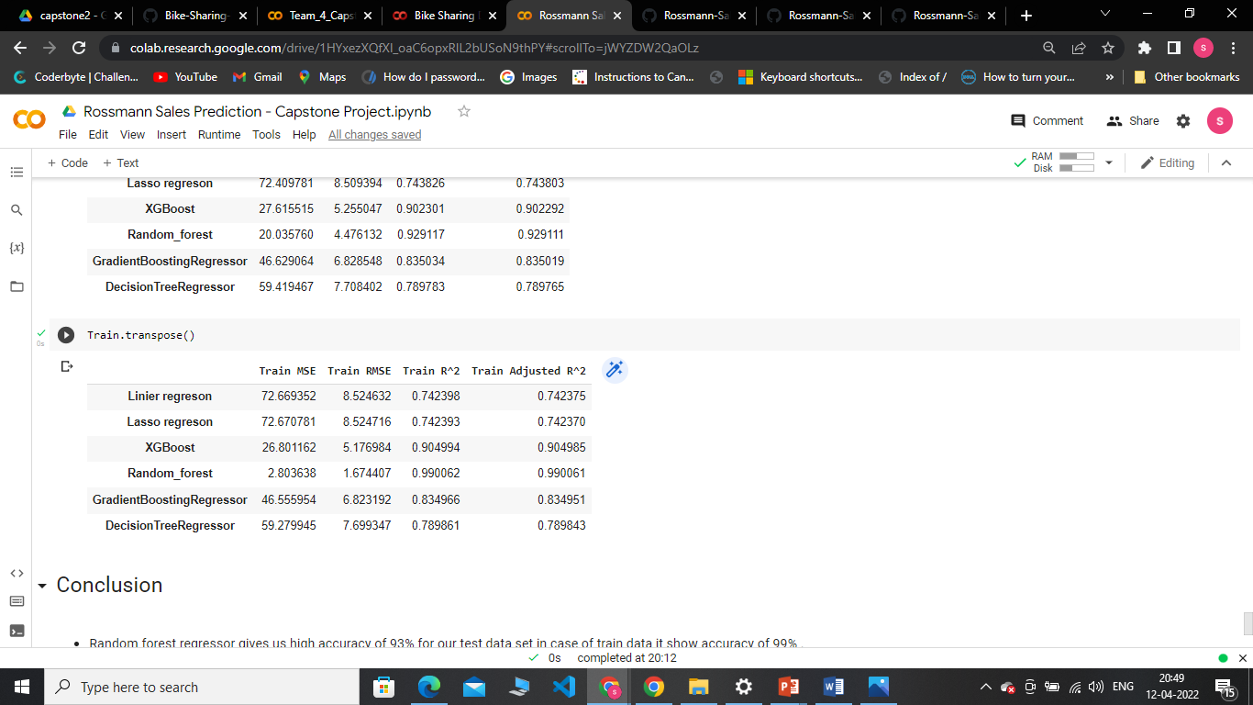
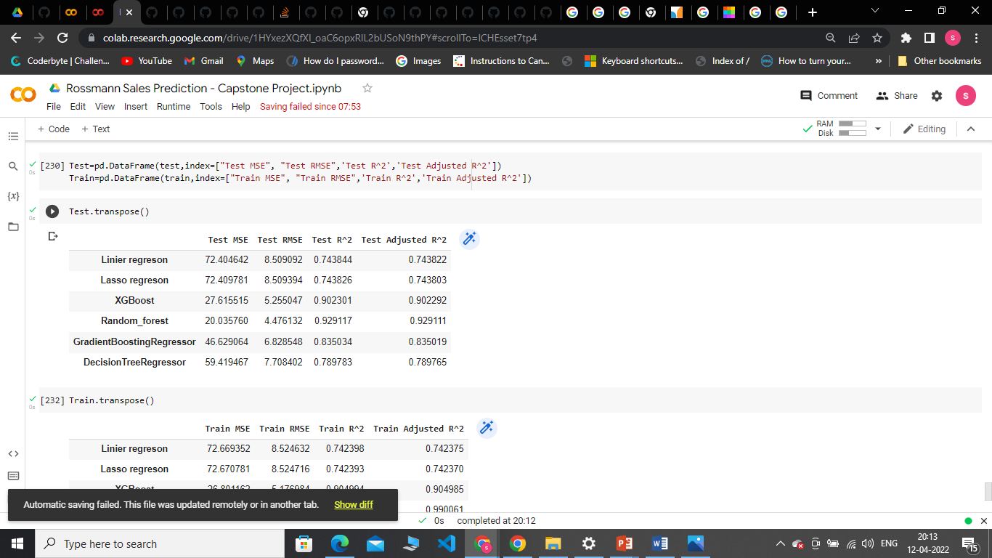
Evaluation of Models
Train
Test

Slide 22
Challenges
Handling large amount of sales data (10,17,210 observations on 13 variable).
When we implement xg-boost or any other tree based algo it take a very long time to run.
Prediction of sales of individual stores(out of 1115) and most of stores have different pattern of sales.

Slide 23
Conclusion
Random forest regressor gives us high accuracy of 93% for our test data set in case of train data it show accuracy of 99% .
Xg boost gives 90% in both train and test case both r2 score and adj r2.
In case of random forest a little bit overfit occur but in xg boost it work properly.
Our base model liner regression create a base line of accuracy of 74%.
The lasso model although we use hyper parameter it gives us similar performance like linear regression.
In case of Decision tree by using decision tree regressor(Hyperparameter) it gives us 78% accuracy in train and 79 accuracy for test case .

Slide 24
Thank you

